Slide 1
Assignment 5 presentation
By: Imani Frederick, Luis Marroquin, & Kevin Perez

Slide 2
Table of Contents
Findings
Associations
Clusters
Regressions
Decision Trees
Recommendations

Slide 3
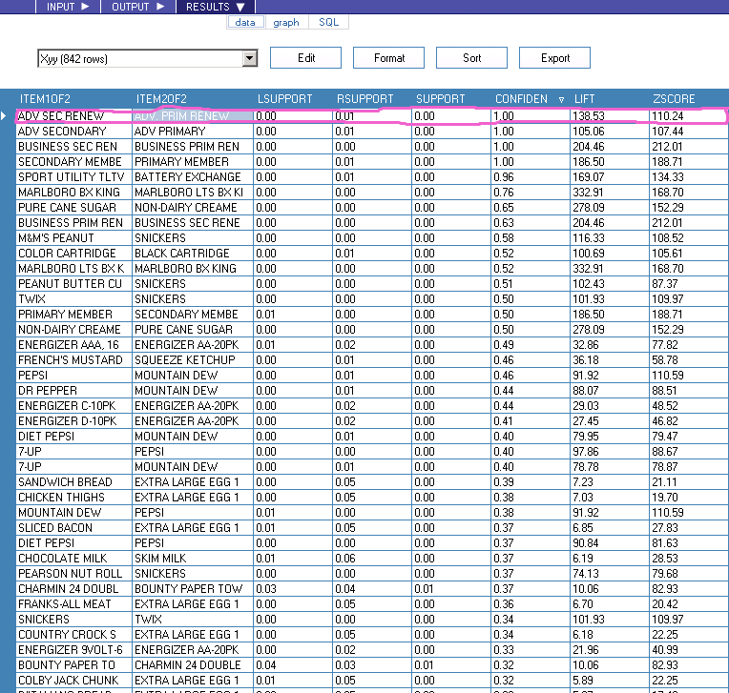
Associations
Market Basket(a)
Here we are performing an Association Analysis on the Visitors Number and the Primary Description of the item purchased.
The strength of an association is measured by its confidence factor, level of support, and lift.
Confidence factor is the percentage that event #2 occurs given event #1 has already occurred.
Support is how frequently the combination occurs in the database.
Lift is the ratio of the confidence factor to the expected confidence factor.
It is important to note that having a high confidence factor with little support, as shown to the right, is not good. (see highlighted region)

Slide 4
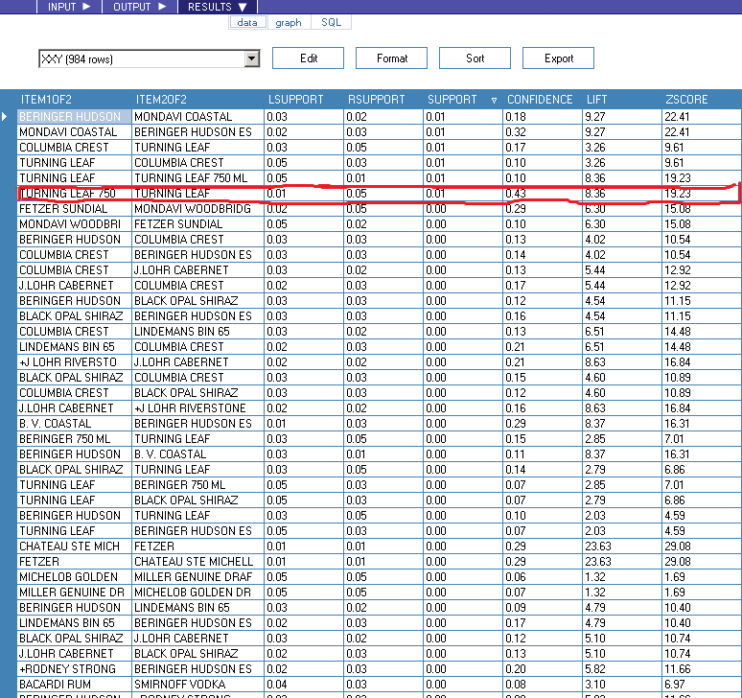
ASSOCIATION Cont…
Market Basket(b)
Here we are performing an Association Analysis on the Visitors Number and the Primary Description of the item purchased, when the number of beers contained in the visitors purchase is equal to 1.
A creditable association has a large confidence factor, a high level of support, and a lift value greater than 1. (see highlighted region)

Slide 5
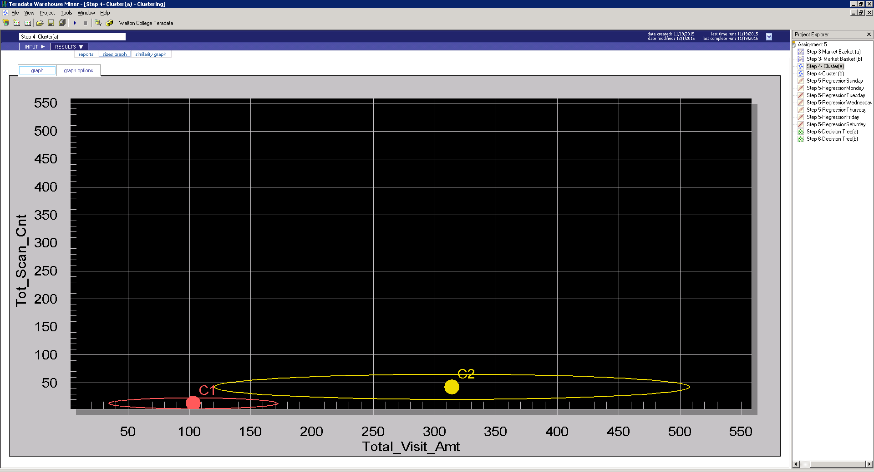
Clusters
Clustering attempts to group records based on their attributes.
The first Cluster Analysis we performed was on the Total Visit Amount and the Total Scan Count.
The findings are below:
Cluster 1 is not as varied as Cluster 2.
However, because Cluster 1 and Cluster 2 do not over lap we can assume that there is little to no similarities between the two clusters.

Slide 6
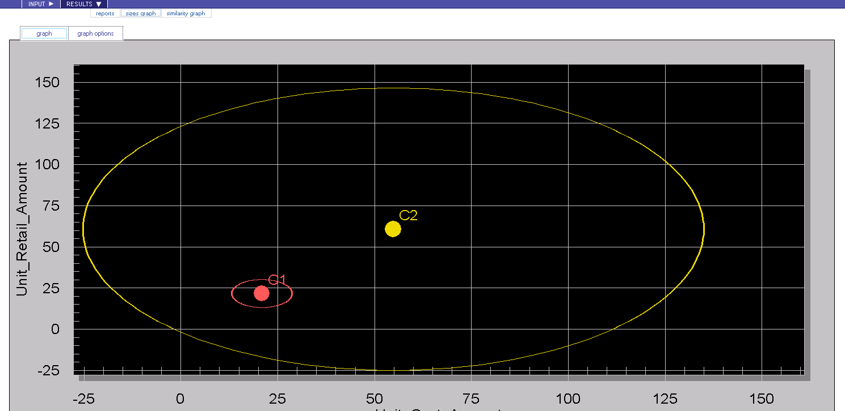
Clusters Cont…
The second Cluster Analysis we performed was on the Unit Retail Amount and the Unit Cost Amount.
The findings are below:
Cluster 2 is extremely varied, in comparison to Cluster 1.
Also, because Cluster 1 is completely engulfed in Cluster 2 we can assume that there is a very strong similarity between the two.

Slide 7
Regression ANALYSIS
Day of the Week | R | Rank
Sunday | 0.0192 | 6
Monday | 0.0089 | 1
Tuesday | 0.0072 | 2
Wednesday | 0.0016 | 7
Thursday | 0.0070 | 3
Friday | 0.0023 | 5
Saturday | 0.0053 | 4
We performed 7 regressions to determine if the day of the week mattered for how large the total visit amount is for beer transactions.
The overall findings are below:
The analysis found that there is a high correlation between beer transactions on a Monday and the total visit amount to the store.
The analysis also found that there is a very low correlation between the numbers of beer transactions on Wednesday and the total visit amount to the store.

Slide 8
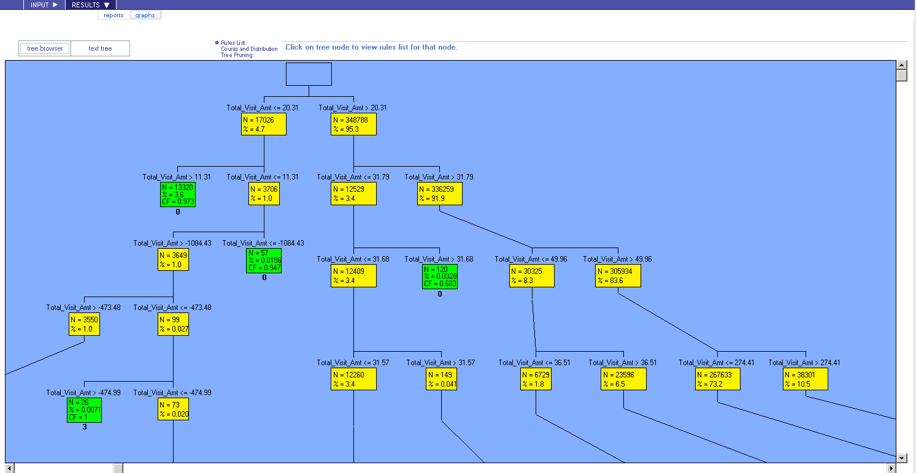
Decision Tree
Decision Tree’s are used to analyze each individual independent variable and determine which variable best predicts the dependent variable.
In the first Decision Tree analysis we are looking to find out if the Total Visit Amount affects the likelihood of how the member will pay for their visit. We also want to know if the member’s zip code has any influence on this scenario.
Findings:
Because the member’s zip code no longer shows up in the variable report we can conclude that is irrelevant to the data.
Based on the leaves, we found that if the Total Visit Amount is greater than or equal to 129.24 then there is a 40.3% chance that this will affect the Tender Type.

Slide 9
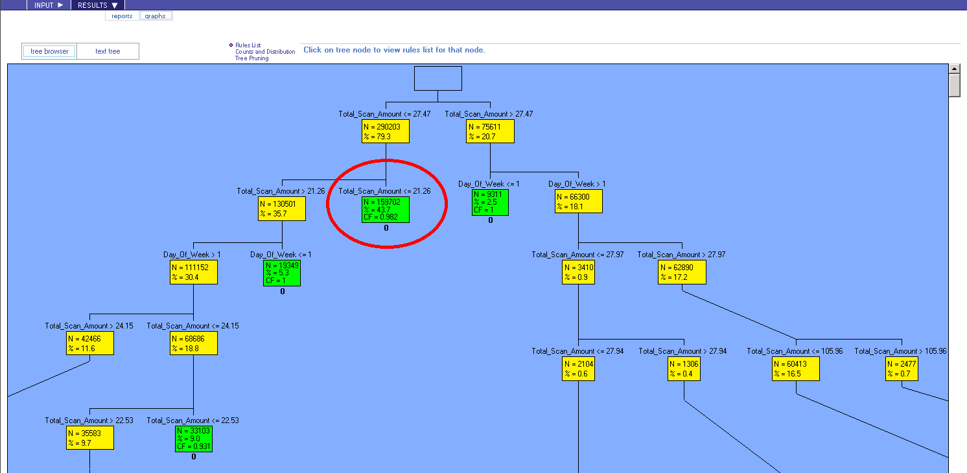
Decision Tree Cont…
The Decision Tree to the right looks to answer the following question: Does the Total Scan Amount and the Day of the Week affect the likelihood that a members transaction includes beer?
Findings:
Due to the fact that the Variable report includes all independent variables we can conclude that all variables were relevant to the completion of the analysis.
Based on the leaves, we found that if the Total Scan Amount is less than or equal to 21.26 then there is a 43.7% chance that this will affect the members decision to purchase beer.

Slide 10
Recommendations to Store Manager
Based on Association Analysis:
In the example (Market Basket(b)) provided, Turning Leaf 750 and Turning Leaf have a high and probable association. We recommend that these items be placed near each other in the store, as well as be placed on sale at the same time to increase profit.
Based on Cluster Analysis #2:
We recommend that the store manager continue what they are doing. There seems to be a similarity in the Unit Cost and the Unit Retail Amount, which means that these prices are not too expensive but there is still room for profit.
Based on Regression Analysis:
Due to the high correlation in purchases of Beer on a Monday, we recommend that the store manager capitalize on these profits and not have promotions on beer for Monday. However, the correlation for beer purchased on Wednesday and Sunday are very low so we recommend full promotions on beer for these days.
Based on Decision Tree Analysis:
In the first Decision Tree example, we found that when the Total Visit Amount is greater than 129 there is an extremely high probability that beer will be purchased. We recommend having a beer tasting event periodically to increase the total amount of visitors and purchases of beer.

